Slide 1

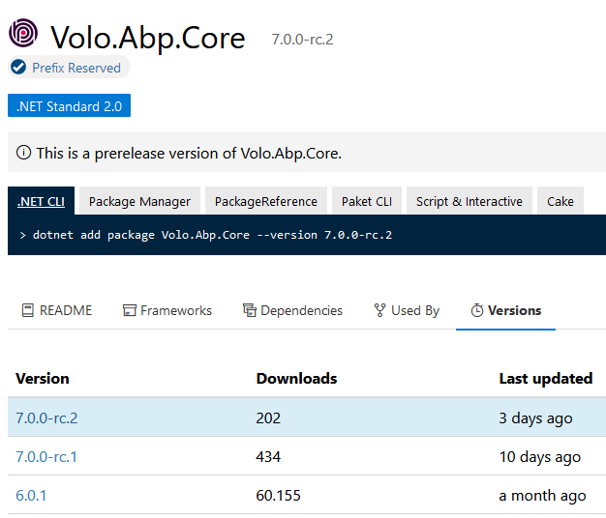
ABP 7 with .NET 7 support
Microsoft released
.NET 7.0.0 stable version
https://dotnet.microsoft.com/en-us/download/dotnet/7.0
ABP 7 preview
with .NET7 support
has been released
Notes:
I will give some community news that has happened since our last community talk.
ABP version 6.0.1 stable has been released.
And also ABP 7 has been released with the .NET7 update.
There are bunch of performance improvements with .NET7 and Entity Framework Core 7.
It’s worth to update your project today.

Slide 2
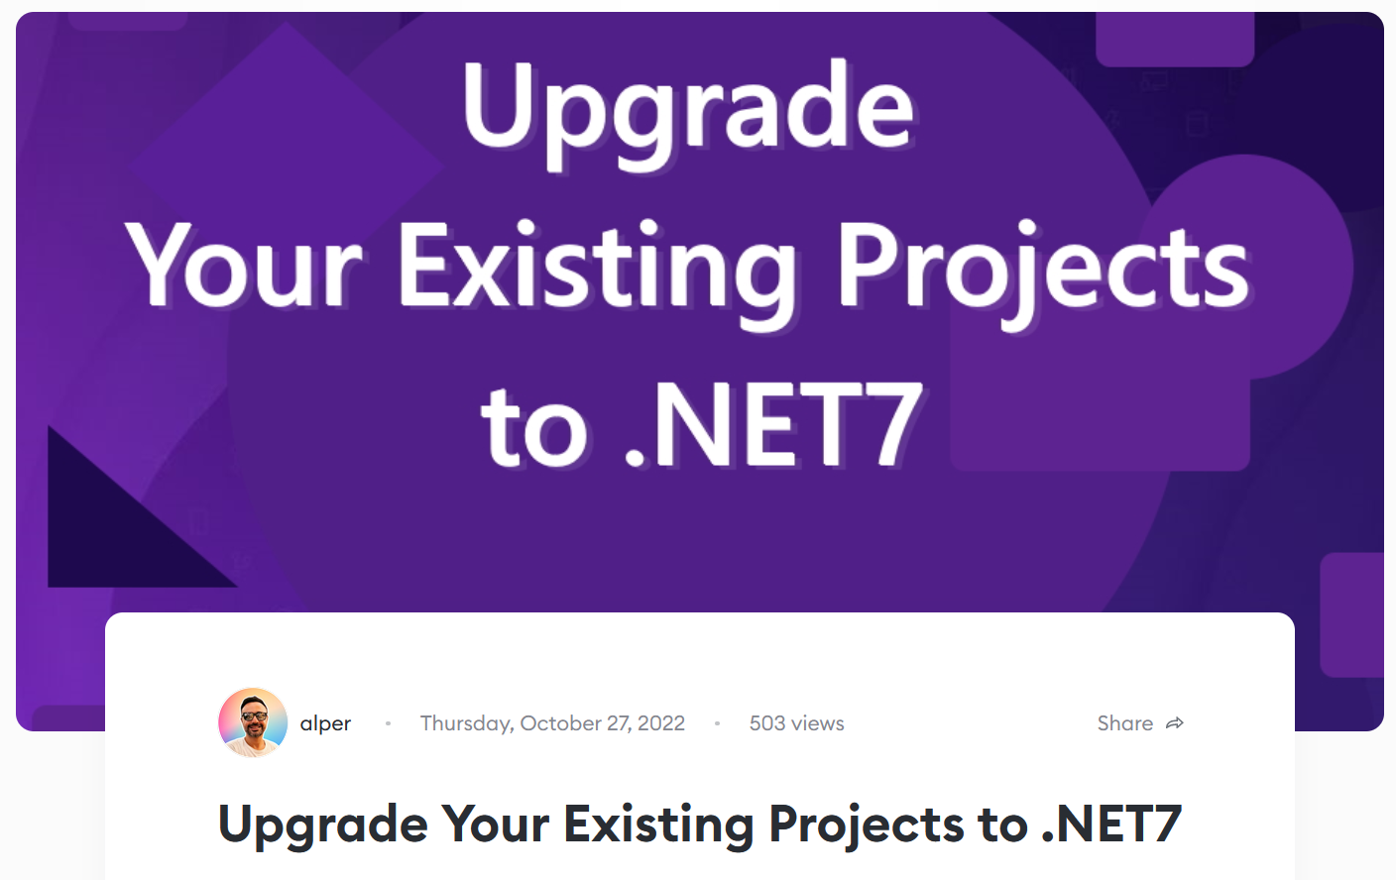
Community Shares
https://community.abp.io/posts/upgrade-your-existing-projects-to-.net7-nmx6vm9m
Notes:
Here’s my latest article about upgrading to the latest .NET 7.
And in this article, I’m sharing my experiences and real world issues when updating our projects to .NET7.

Slide 3
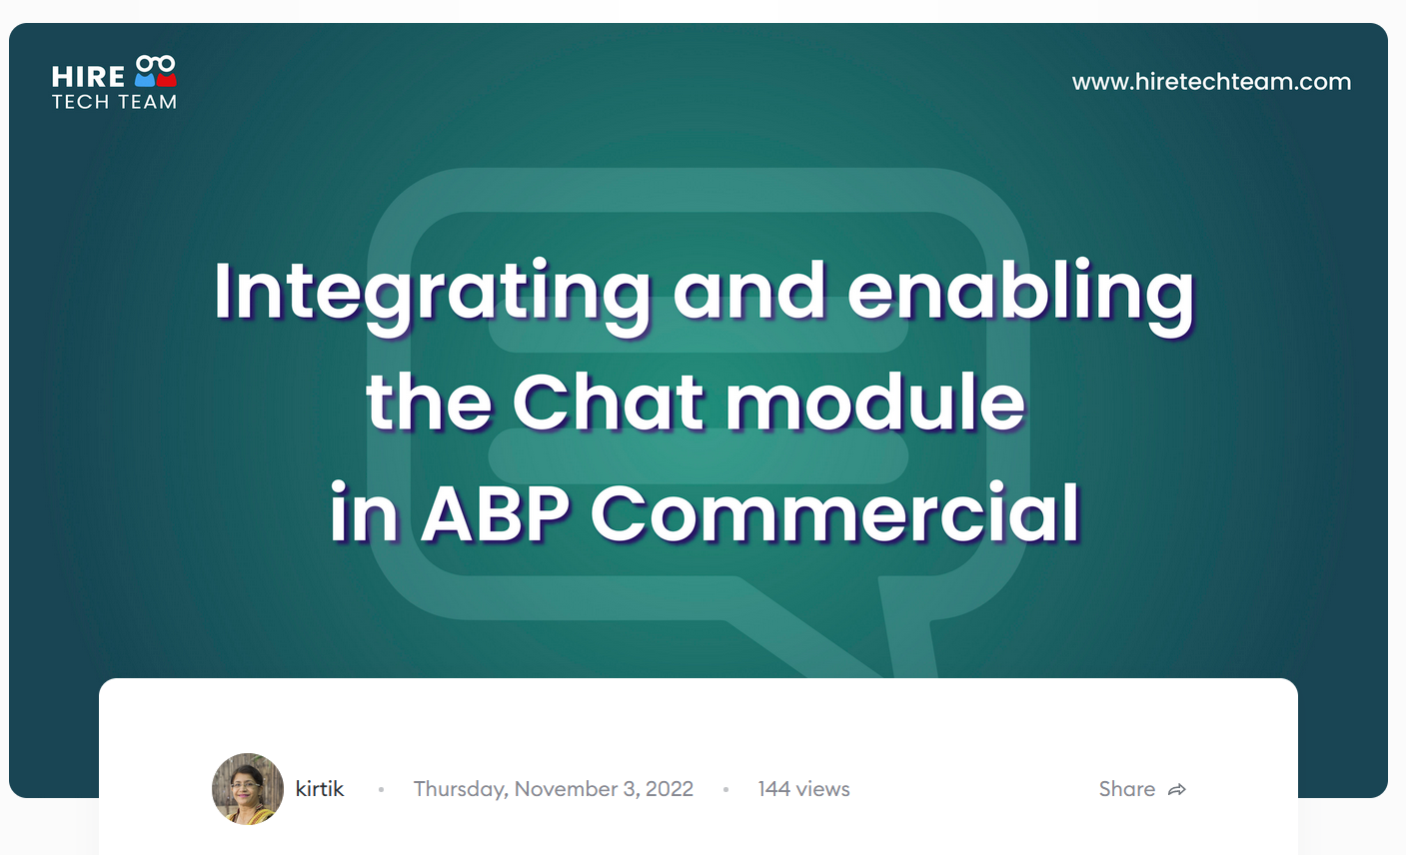
Community Shares
https://community.abp.io/posts/integrating-and-enabling-the-chat-module-in-abp-commercial-vsci3ov2
Notes:
ABP Chat module implements real time messaging between users in your ABP application.
As you know, chat module doesn’t come integrated out of the box.
You need to add it manually.
In this article, Kirti Kulkarni explains how you can integrate and enable the ABP chat module.

Slide 4
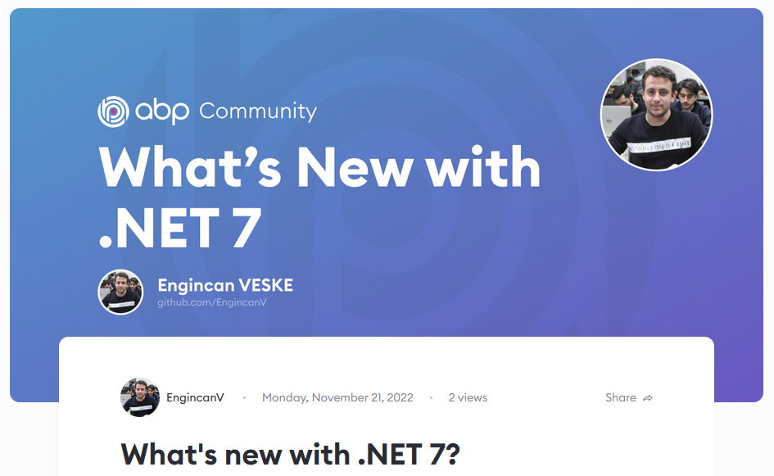
Community Shares
https://community.abp.io/posts/whats-new-with-.net-7-tlq2g43w
Notes:
Engincan has a new article about .NET 7 features.
He’s mentioning some interesting features that are now available with the release of C# 11 and .NET 7.

Slide 5

Community Shares
The new EF Core Interceptors
https://community.abp.io/posts/the-new-ef-core-interceptors.-gzpm29hp
Notes:
Liming Ma wrote article about The new EF Core interceptors comes with EF Core 7.
The new interceptors are intercepting; new entity creation and population of the entity, modifying the LINQ expression tree, optimistic concurrency handling and so on…

Slide 6
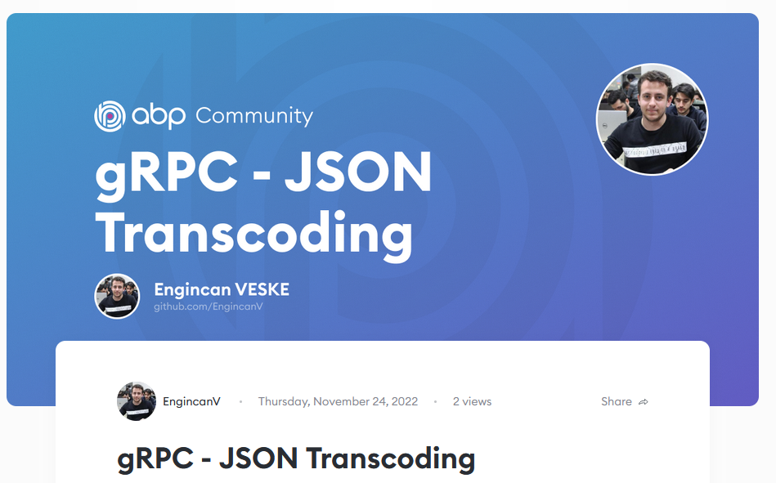
Community Shares
https://community.abp.io/posts/grpc-json-transcoding-16eai2zw
Notes:
In this article Engincan shows one of the new features that came with .NET 7
It’s called JSON Transcoding.
By using JSON Transcoding, we can expose our gRPC services and access them via HTTP call.

